Slide 1
Aerodynamic Design of a Fowler Flap for a Hybrid Laminar Flow Control Airfoil
Holenarsipura, Shrinidhi, 06/05/2025
Advisor,
Dr.-Ing Stanislav Karpuk
Notes:
Good Afternoon Everyone, Thank you for joining for the presentation of my Studienarbeit titled “Aerodynamic Design of a Fowler Flap for a Hybrid Laminar Flow Control Airfoil”, under the guidance of Dr. Karpuk. I hope you can take away something new this afternoon.

Slide 2
Contents
Tasks
Objective
Introduction
Methodology
Trade studies
Results
Summary
Future work
Notes:
In today's presentation I will take you through the tasks undertaken, objective of the research followed by the Introduction, Methodology, Trade studies performed, Results obtained, Summary and Future work at the last

Slide 3
Contents
Tasks
Objective
Introduction
Methodology
Trade studies
Results
Summary
Future work
Notes:
Starting with the Tasks and Objective

Slide 4
Tasks
Define and modify an existing design methodology for a rapid CFD analysis of airfoils.
Perform parametric studies of a Fowler flap.
Obtain a new design and compare key aerodynamic characteristics between the original and the final configurations.
Objective
Maximize lift for takeoff (15°) and landing (30°) flap settings.
Notes:
The main tasks for this Studienarbeit was to define and modify the existing methodology
Followed by performing parametric studies of the Fowler Flap
And obtaining a new design and comparing key aerodynamic characteristics between the baseline and the final configuration
The objective was to maximize the lift for at 15° and 30° flap deflections, corresponding to the take off and landing configurations.

Slide 5
Contents
Tasks
Objective
Introduction
Methodology
Trade studies
Results
Summary
Future work
Notes:
Starting with the Introduction

Slide 6
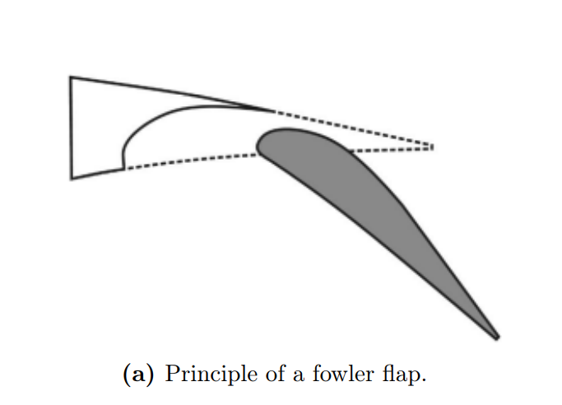
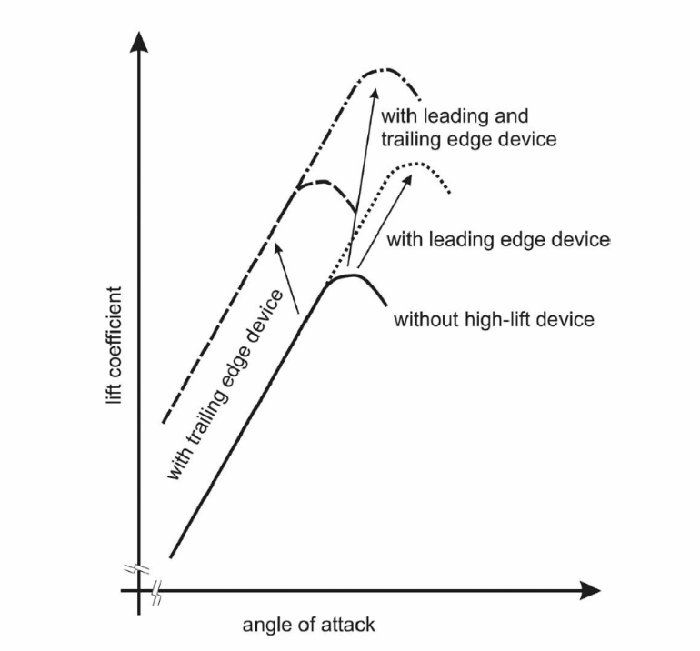
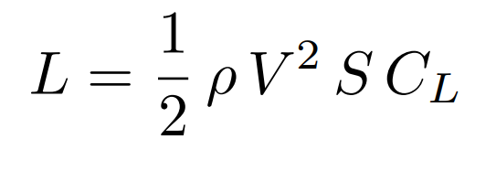
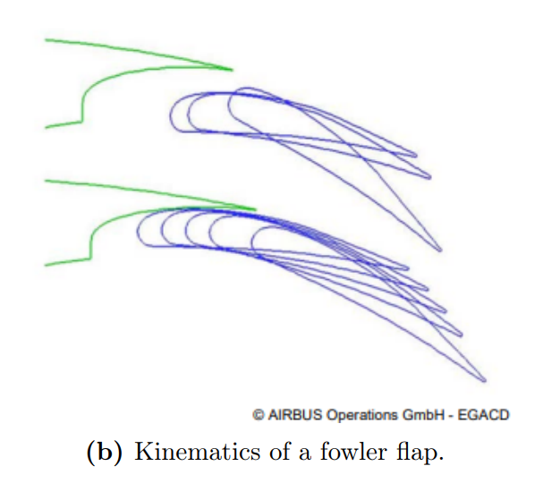
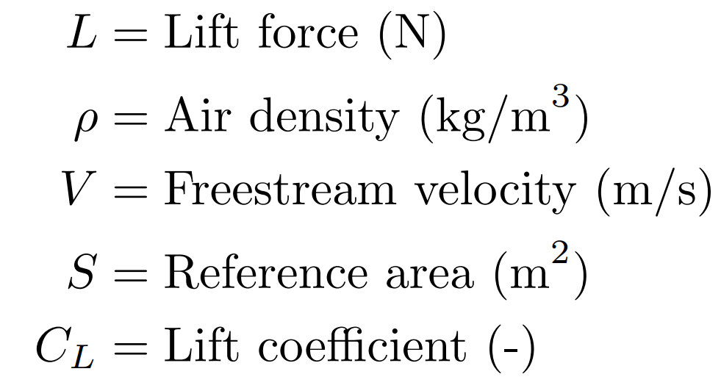
High-lift devices
Fig 1: Effect of high-lift devices
on the lift coefficient (C_{L}) and the angle of attack (α) [1].
Fig 2: Mechanism of the Fowler flap
[1], [2].
Notes:
The formula in the middle represents how Lift is defined
Lift can be increased by
Either increasing the density of air – impossible at landing and take off conditions
Change in velocity – not possible at landing condition because we need to land at reduced velocity for safer landing
Change in reference area – Yes, with devices such as the Fowler flaps with the mechanism on the right, where they extend outward and downward – But, not by much
Change in the Lift Coefficient – Yes, by making the design more aerodynamic, increasing the overall lift and reduce drag – Substantial increase in Lift
The question is Why are high lift devices such as Fowler Flaps necessary?
The answer is, they offer higher Lift coefficients at the same angle of attacks and also delay flow separation
But, how is it beneficial?
The fig on the right represents how a fowler flap works, it extends outwards and downwards – effectively increasing the camber, and also the reference area The flap deflection creates pressure distribution – crucial for lift generation followed by Increased Circulation and the Slot Effect – reenergizing the boundary layer and delaying flow separation.

Slide 7
Contents
Tasks
Objective
Introduction
Methodology
Trade studies
Results
Summary
Future work

Slide 8
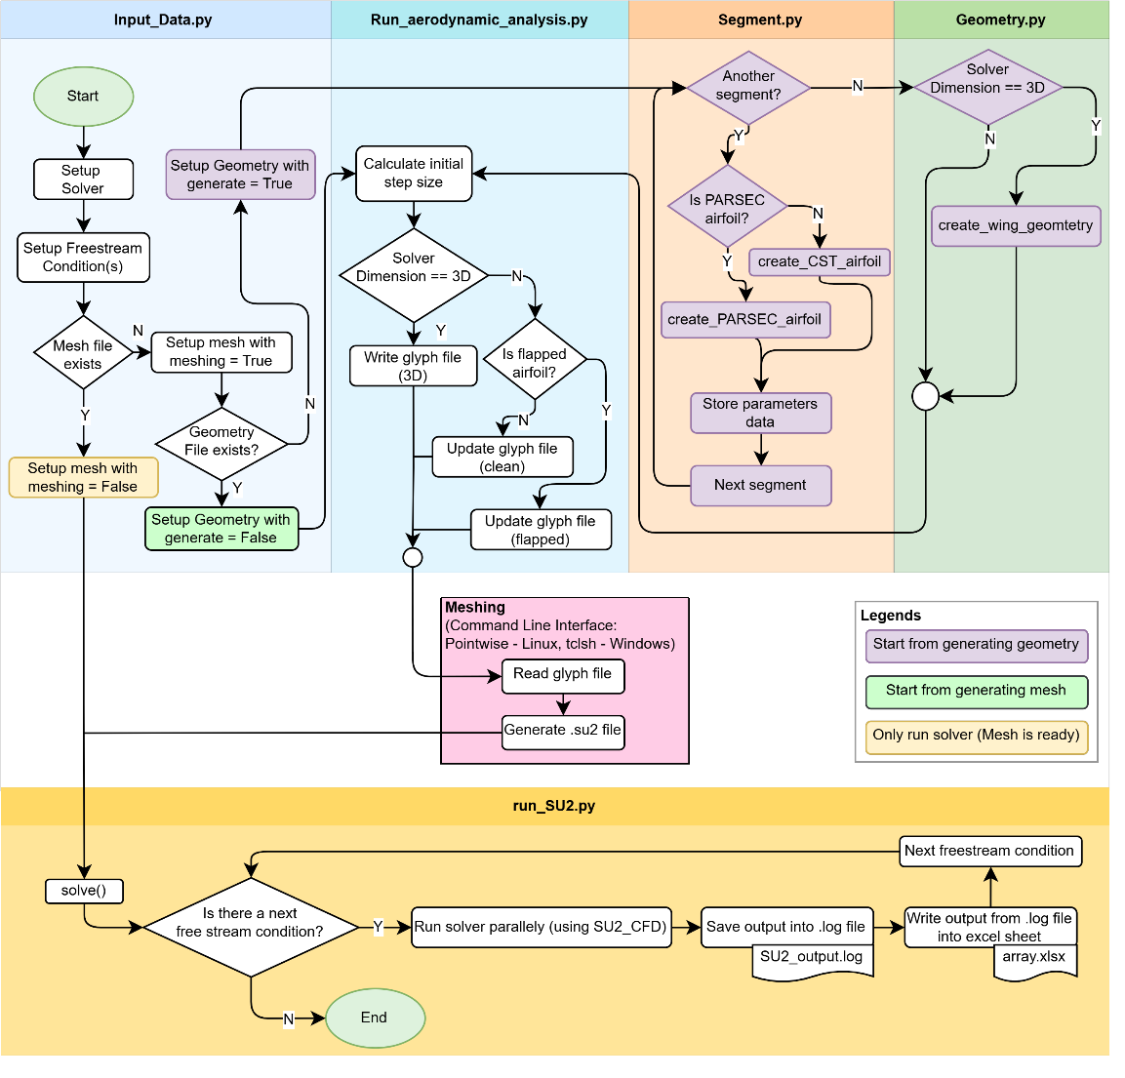
PyAeroSweep framework
Python
Fidelity Pointwise
Fig 6: PyAeroSweep
Framework.
SU2_{CODE}
Notes:
One of the most integral part of this research is The PyAeroSweep is a Python based framework that automates Pre-Processing Meshing CFD analysis
Processes – Developed by Dr. Karpuk, here at the IFL. It uses Fidelity pointwise as the CFD meshing tool with commands written into the native Glyph scripts with mesh configurations
And SU2 - an Opensource CFD solver coupled with RANS simulations.
The Input Data module contains all the user defined inputs such as the mesh settings, free stream conditions and convergence criterias This is then (Explain the flow chart)…..

Slide 9
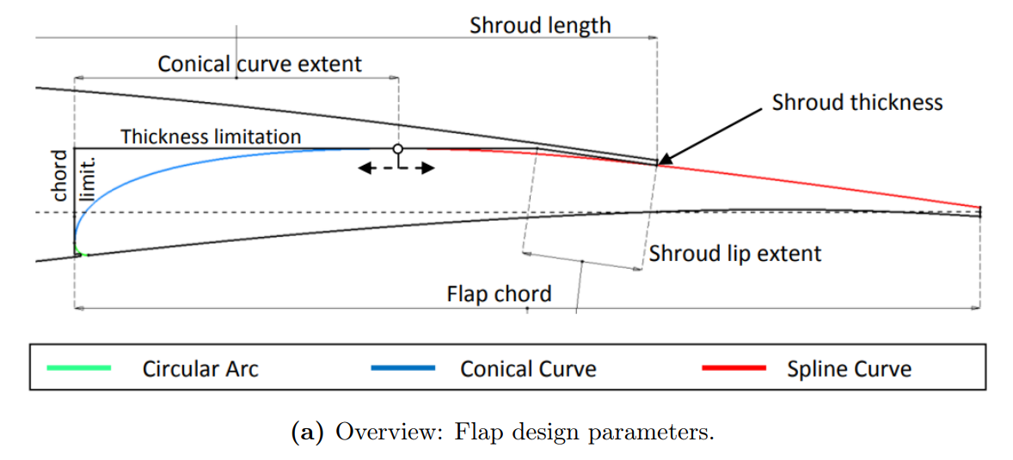
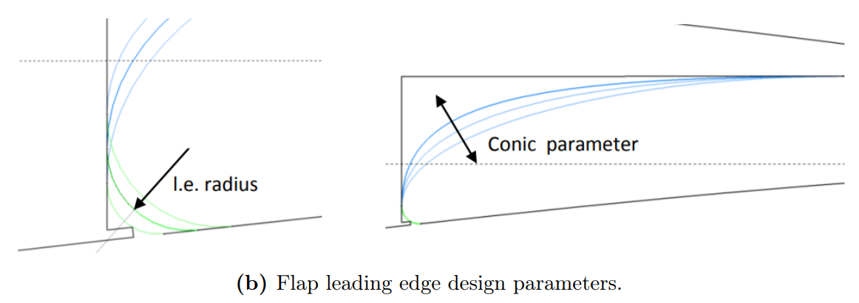
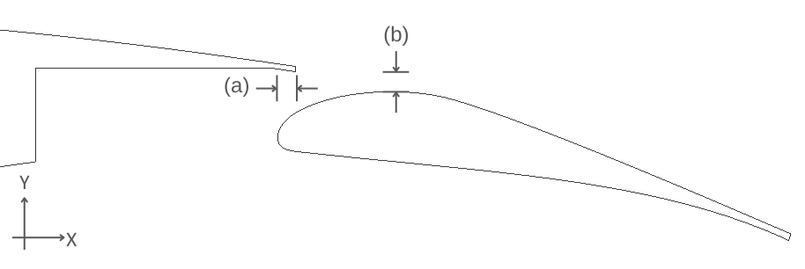
Geometry definition
Fig 3: Key flap geometry definitions [3].
Fig 4: (a) Horizontal overlap x_gap and (b) Vertical gap y_gap definition.
Notes:
The 3 key geometric curves used in geometric definition are:
Circular Arc
Conical Curve
Spline Curve
As represented in Figure 3 in green, blue and red colors.
This has been adopted from previous research.
But, 2 distinct parameters
X GAP
Y GAP
Are added to the geometric parameters, wherein these two parameters play a major role wrt flap aerodynamics.

Slide 10
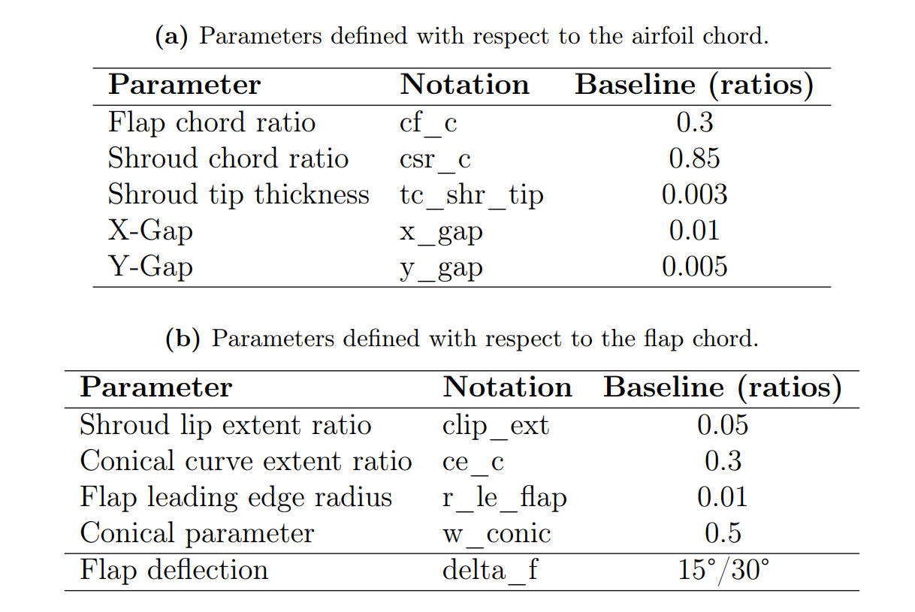
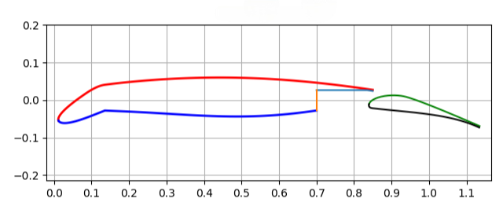
Geometric parameters – baseline flap
Fig 5: PARSEC airfoil.
15° droop nose
15°/30° flap deflection
Table 1: Geometric parameters for the baseline flap design.
Notes:
Figure 5 represents the PARSEC airfoil including the flap – deflected at 15 ° and the nose drooped at a fixed angle of 15°.
The table to the right represents the parameters of the Flap, defined wrt
Airfoil and
Flap
With the baseline values for each.

Slide 11
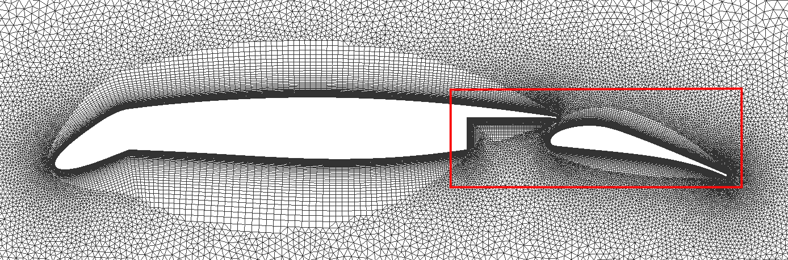
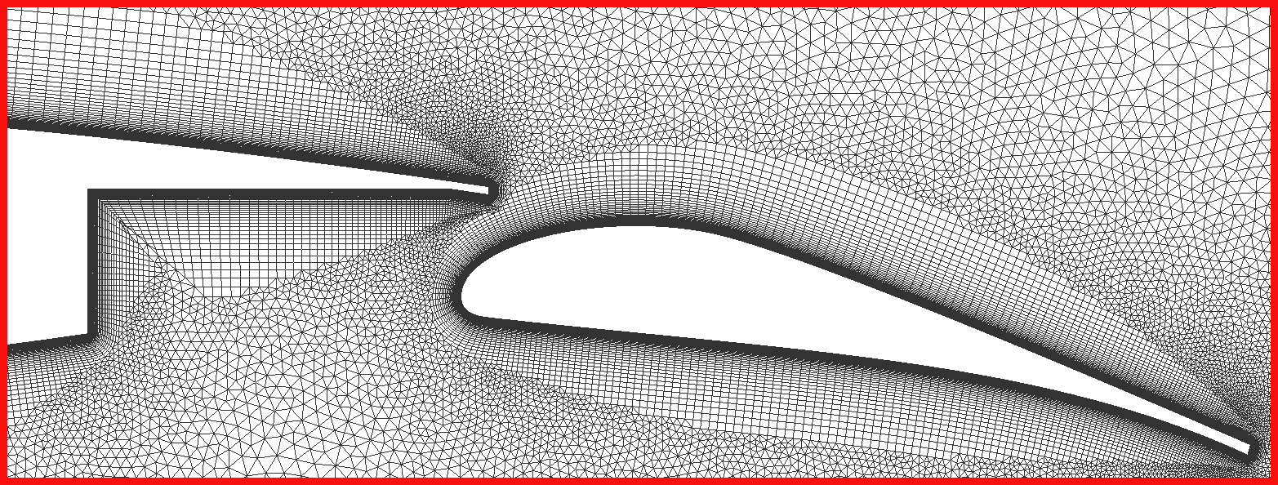
Mesh generation – Fidelity Pointwise
Fig 7: Computational mesh around the HLFC airfoil.
Fig 8: Detailed view of the computational mesh around the Fowler flap.
Notes:
The computational mesh is generated with Poitnwise is primarily Unstructured with viscous mesh near the airfoil and flap surfaces. This is crucial for accurately capturing the aerodynamic behavior, particularly the boundary layer effects and flow phenomena.

Slide 12
CFD solver – SU2
Steady-state Reynolds-Averaged Navier-Stoken (RANS) equations.
k −ω SST (Shear Stress Transport) – Two equation turbulence model.
Better handling of adverse pressure gradients and flow separation.
Enhanced near-wall resolution.
k: Turbulent kinetic energy (m²/s²)
ω: Specific Rate of Dissipation (1/s)
Notes:
This research uses Steady state RANS equations coupled with KW SST turbulence model
PyAeroSweep is limited to steady state simulations, but the choice of KW SST turb model was made
due to it being a two-equation model
Handles adverse pressure gradient better
Favorable capturing of near wall effects

Slide 13
Contents
Tasks
Objective
Introduction
Methodology
Trade studies
Results
Summary
Future work

Slide 14
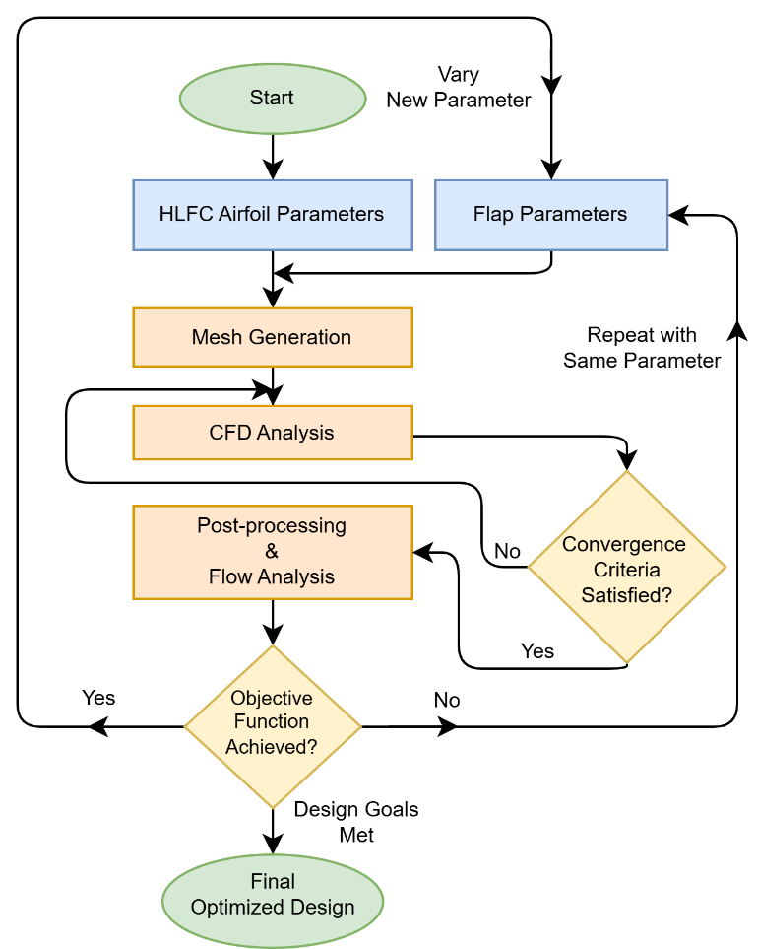
Optimization strategy
OAT One-At-A-Time Optimization
Fig 9: Fowler flap design optimization strategy.
Notes:
As manual optimization was employed in this research, One at a time optimization means – varying one parameter and keeping the rest constant.
Find an optimum, change he values to optimum and then vary the rest.
As this research is only for flap design optimization, airfoil parameters were kept constant.
This was done until all the parameters were optimized and an optimized design with improved lift performance was obtained.

Slide 15
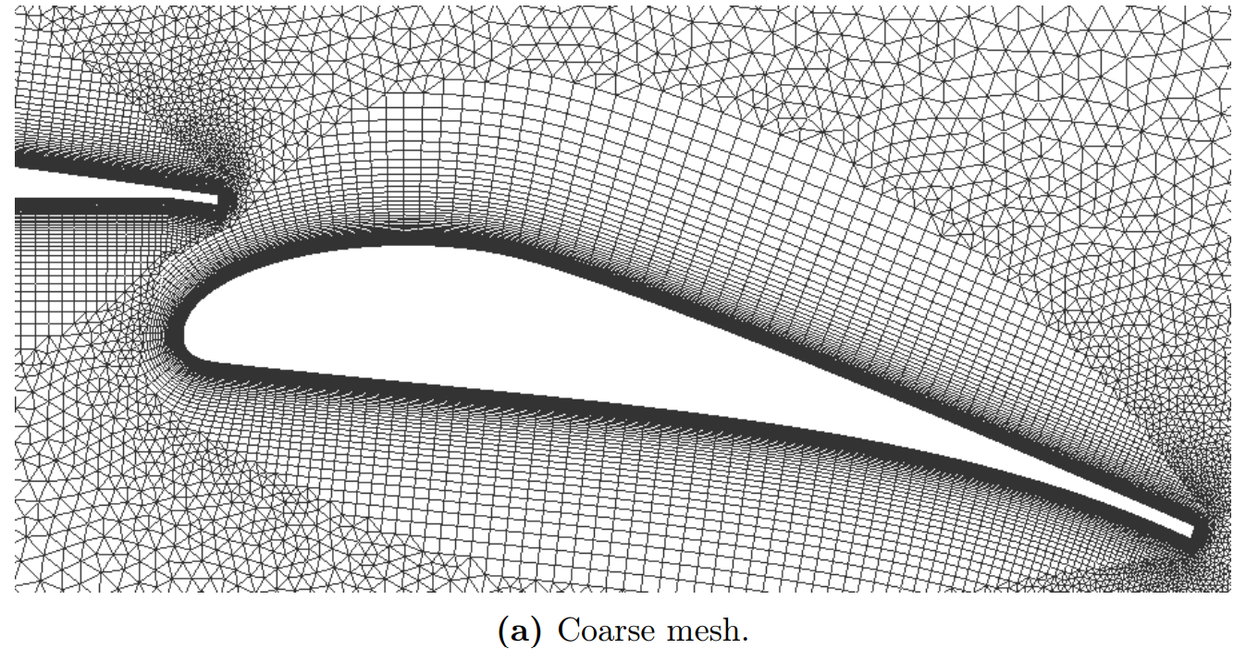
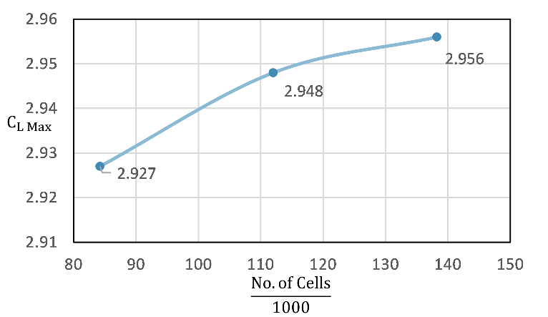
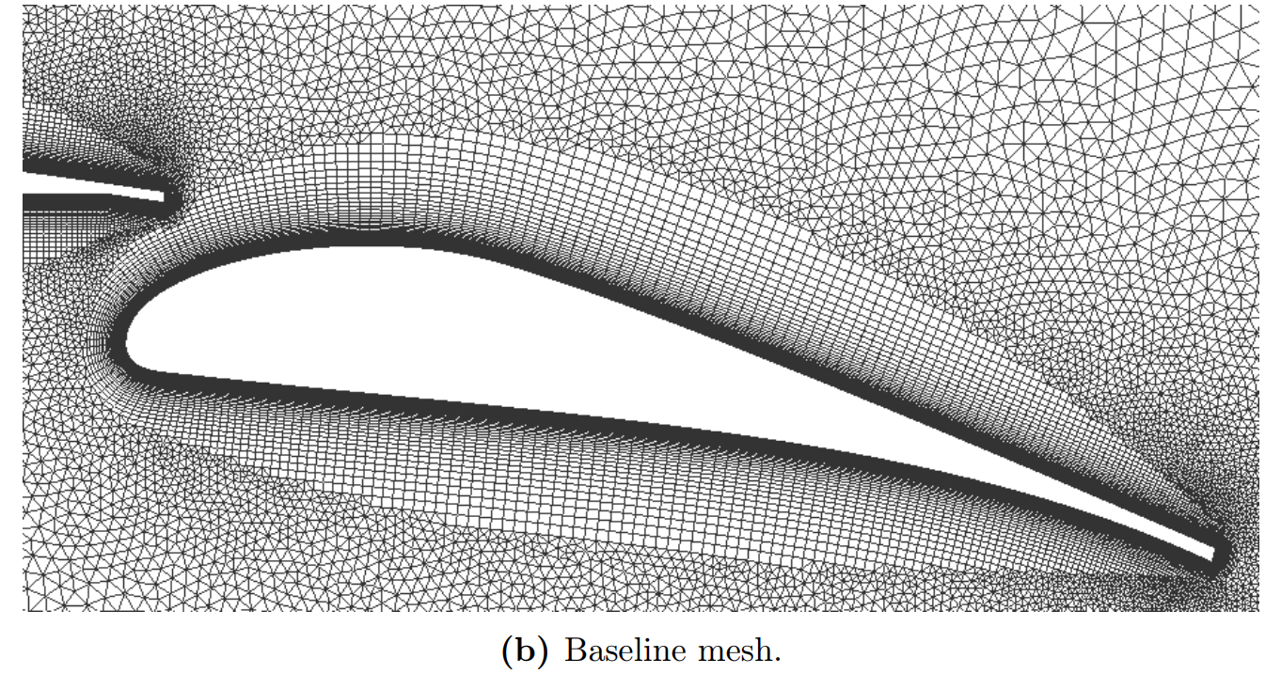
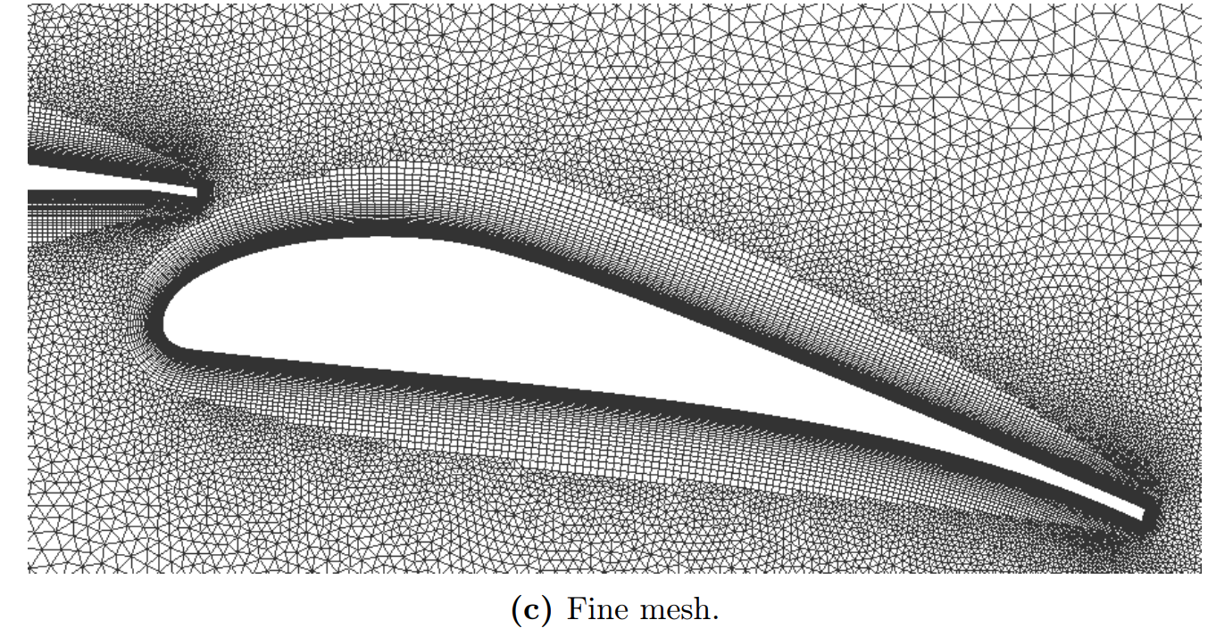
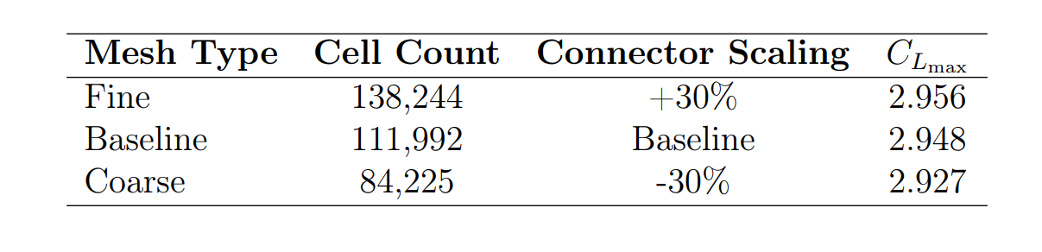
Mesh sensitivity study
Fig 11: Effect of mesh refinement on grid resolution.
Fig 10: Impact of mesh refinement on maximum lift coefficient (C_{Lmax} ).
+0.27%
+0.71%
Table 2: Results of the mesh sensitivity study.
Notes:
Mesh sensitivity study was performed to determine if the baseline mesh was sufficient to perform optimization studies.
30+ finer and 30- coarser mesh were compared
Coarser mesh to baseline - 0.71% improvement in Cl max – which is significant
Baseline to Fine – 0.27% - still significant, but comes at an increased simulation time
I used a normal workstation with basic PC configurations. Since I had to balance the practicality, accuracy and available computational resource, the baseline mesh offered a balance between these criteria's.

Slide 16
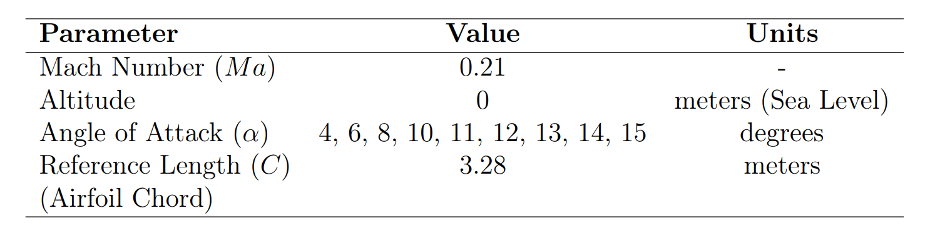
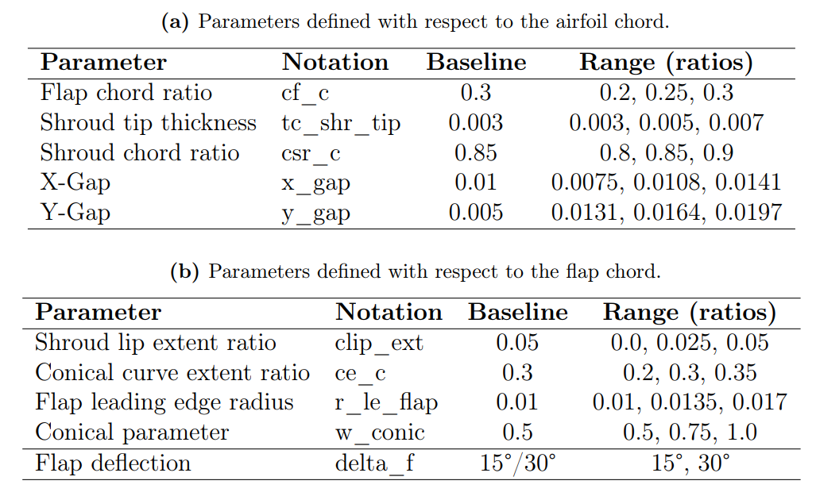
Parameter sensitivity study
Table 4: Range of geometric parameters for the to-be optimized flap design.
Table 3: Simulation freestream conditions and reference length (airfoil chord).
Notes:
Ranges – Chosen based on
Previous research data
Geometric feasibility through visual inspection
Tested for 15° first – Less Sensitivity
Moved on to 30° deflection
x_gap, y_gap showed more sensitivity

Slide 17
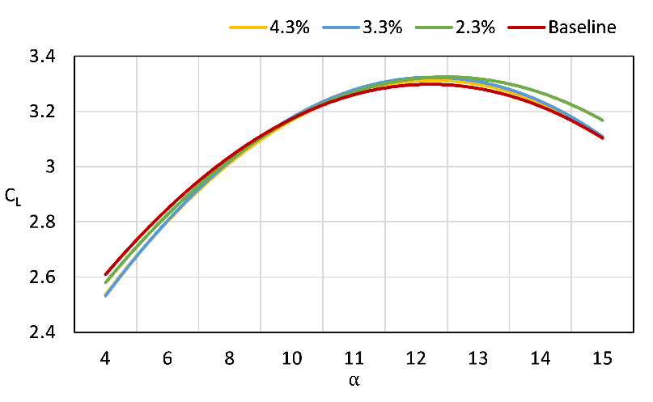
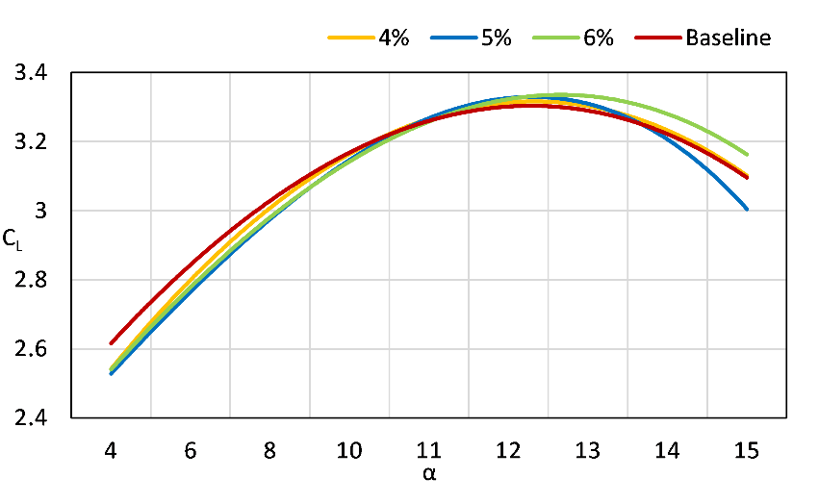
Effect of variation of x_gap & y_gap on C_{D} and C_{L} varied across α:
Figure 12: Effect of variation of x_gap on C_{L} vs α, with y_gap fixed at 4.0%
of the airfoil chord.
Figure 13: Effect of variation of y_gap on CL vs α, with x_gap fixed at 4.3% of the airfoil chord.
Baseline:
x_gap 3.0 % y_gap 1.5 %
Notes:
x_gap varied – y_gap fixed
2.3% behaves similar to baseline at low AoA
y_gap varied – x_gap fixed
6% achieves higher Clmax as AoA increases

Slide 18
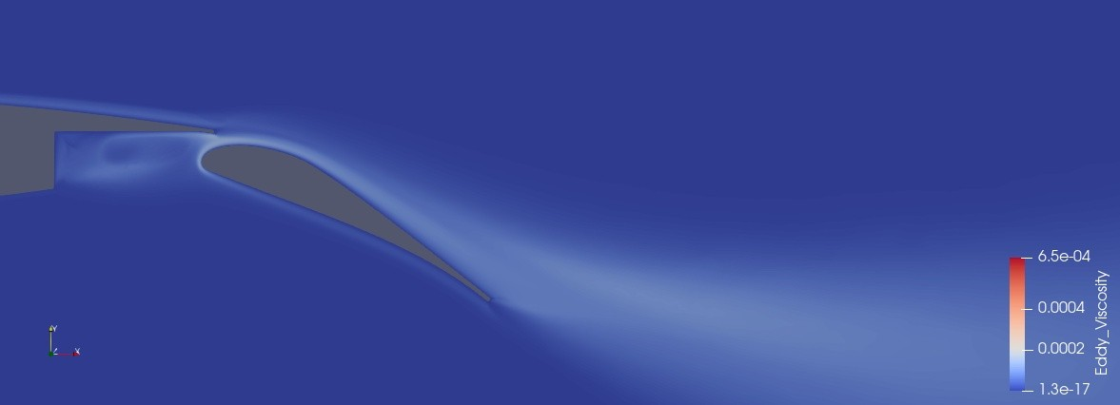
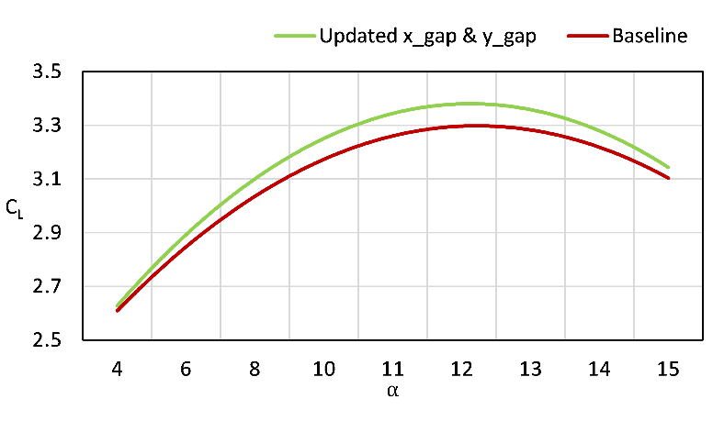
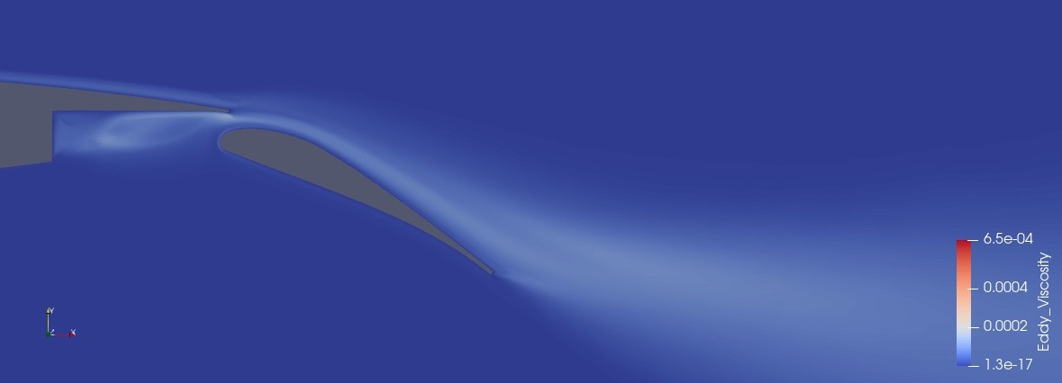
Updated x_gap & y_gap
Fig 18: Baseline configuration
(x_gap at 3.0% & y_gap at 1.5% of the airfoil chord).
Figure 17: Comparison of baseline and updated configuration
(x_gap at 2.3% and y_gap 6.0%).
2.43 % increase in C_{Lmax}
30° flap deflection
4° Angle of attack
Fig 19: Updated configuration
(x_gap at 2.3% & y_gap at 6.0% of the airfoil chord).
Notes:
Attempt was made to combine the effects
Performs better over the entire range of AoA

Slide 19
Contents
Tasks
Objective
Introduction
Methodology
Trade studies
Results
Summary
Future work
Notes:
The effect of x and y gaps on Cl max was significant
But, other parameters also helped in the overall optimization
Though, their individual contribution was comparatively less, their combined effect played a major role in maximizing the lift

Slide 20
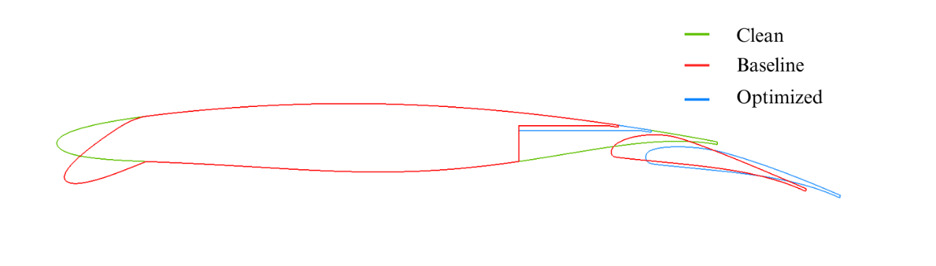
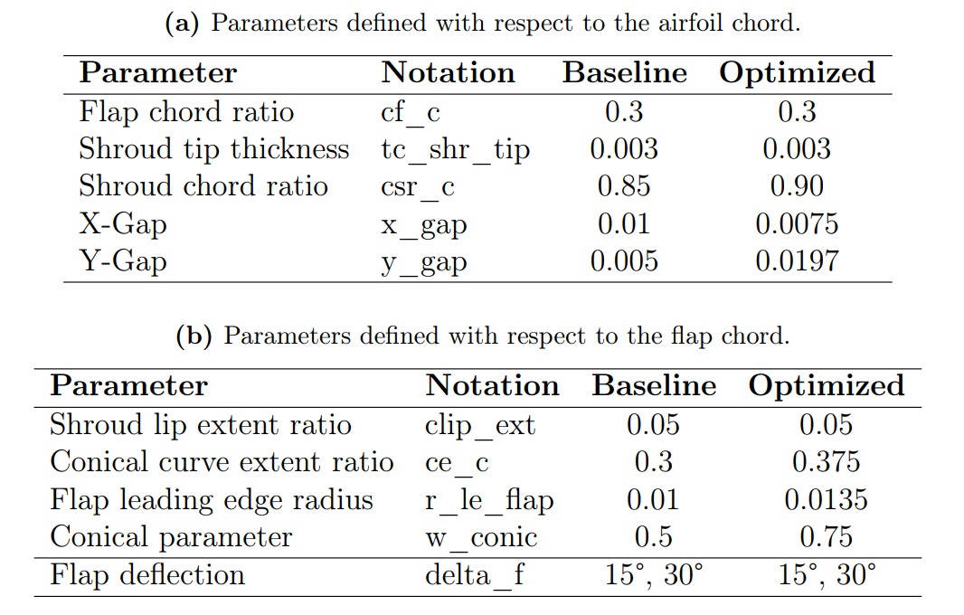
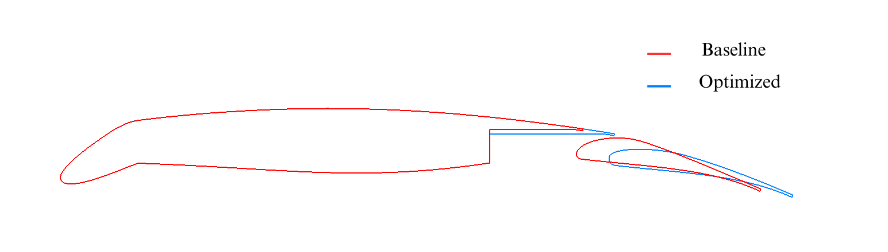
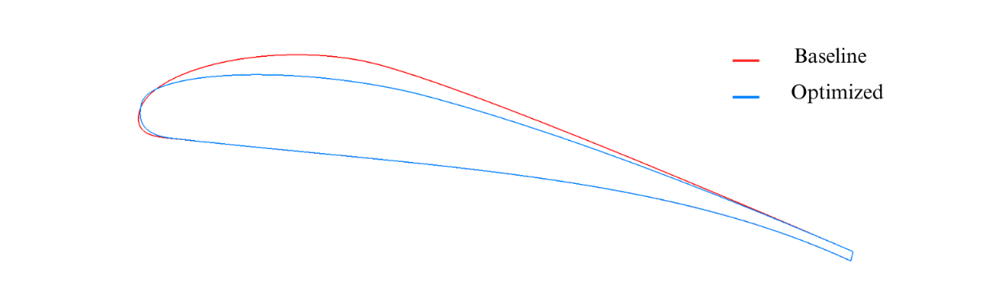
Results
Table 5: Baseline and optimized flap design parameters (in ratios).
Fig 20: Comparison of baseline and optimized airfoil and flap geometric profiles (all parameters optimized).
Notes:
The table to the left showcases the optimized parameter values vs the baseline
The image to the right shows a comparison of he baseline, clean and the optimize design
The image in the bottom left of the Fowler flap shows noticeable changes to the leading edge and the conical parameters near the LE and on the suction side.

Slide 21
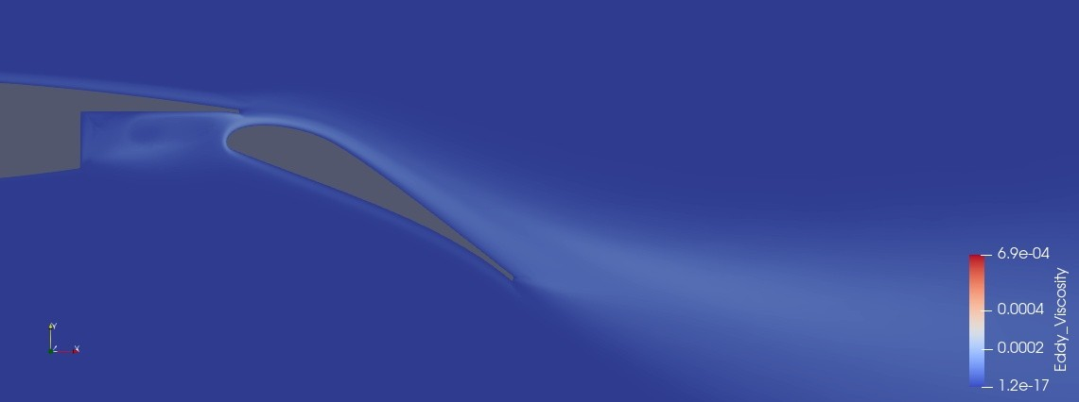
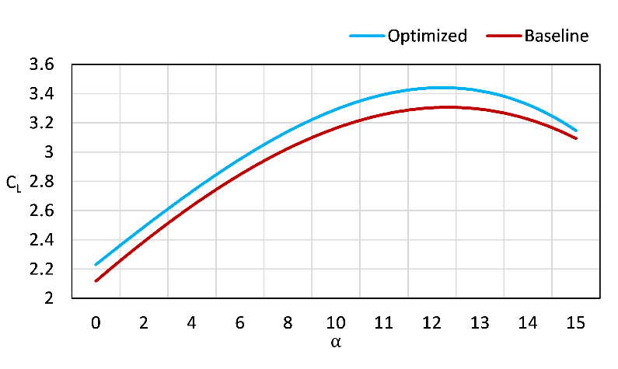
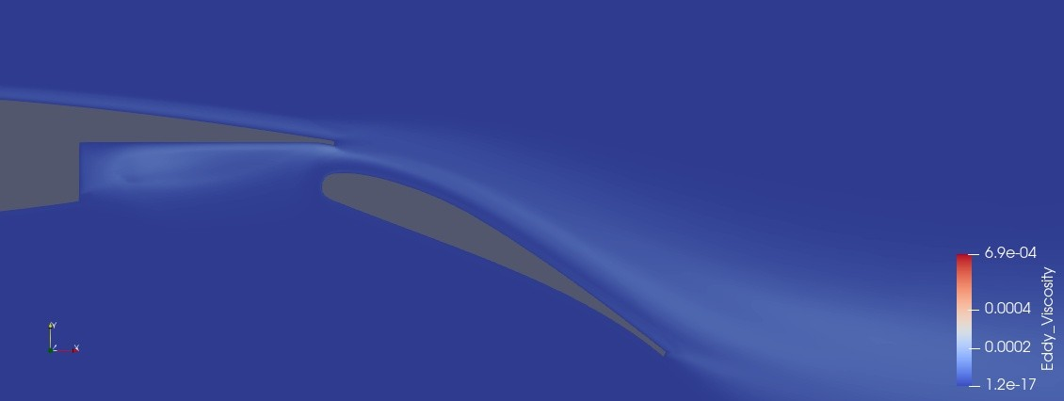
Aerodynamic performance at 30-degree flap deflection
Fig 22: Eddy viscosity: Baseline configuration.
Figure 21: Comparison of baseline and optimized configuration (C_{L} vs α).
4.56 % increase in
C_{Lmax}
30° flap deflection
4° Angle of attack
Fig 23: Eddy viscosity: Optimized configuration
(all parameters optimized).
Notes:
Channel flow is cleaner
LE has less disturbed flow
Does not disturb the recirculation inside the flap cutout
Cleaner flow on the suction side

Slide 22
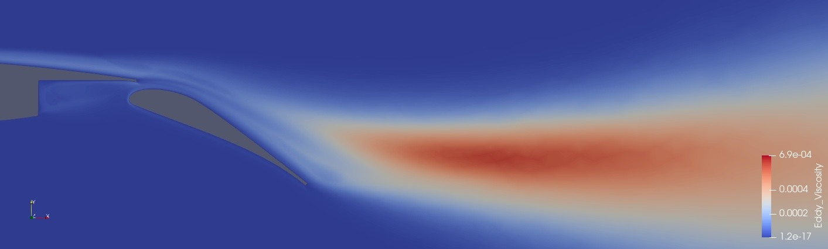
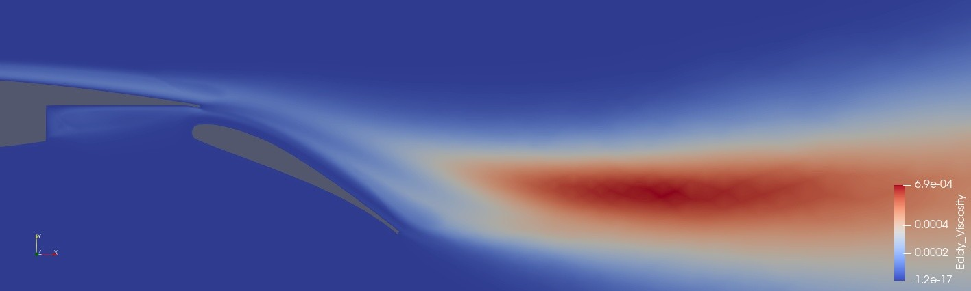
Aerodynamic performance at 30-degree flap deflection
Fig 25: Eddy viscosity: Baseline configuration.
Figure 21: Comparison of baseline and optimized configuration (C_{L} vs α).
4.56 % increase in
C_{Lmax}
30° flap deflection
13° Angle of attack
Fig 26: Eddy viscosity Optimized configuration
(all parameters optimized).
Notes:
Even at higher AoA, the optimized flap continues to exhibit favorable flow around the flap.

Slide 23
Contents
Tasks
Objective
Introduction
Methodology
Trade studies
Results
Summary
Future work
Notes:
The analysis was also conducted for the 15-degree flap deflection with the optimized parameters and the following results were obtained.

Slide 24
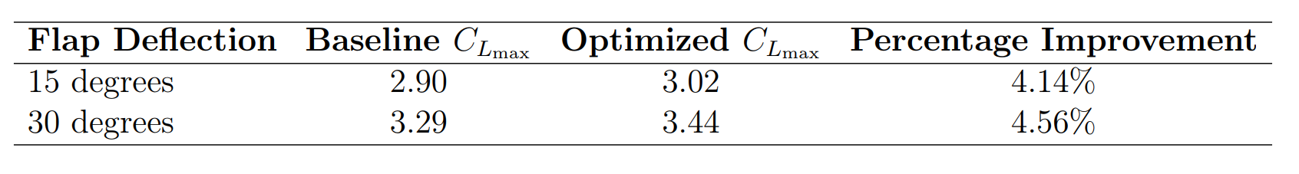
Summary
1000+ CFD runs, manually optimized and post-processed.
10 parameters varied.
Tested for:
15° flap deflection.
30° flap deflection.
Table 6: Summary of maximum lift coefficient (C_{Lmax}) improvements.

Slide 25
Contents
Tasks
Objective
Introduction
Methodology
Trade studies
Results
Summary
Future work

Slide 26
Future work
Unsteady Reynolds-Averaged Navier-Stokes (URANS).
Implementing:
Surrogate-Based Optimization.
Automatic Optimization Algorithms.

Slide 27
References
[1] Jochen Wild. High-lift aerodynamics. CRC Press, 2022
[2] Henning Strüber. ‘The aerodynamic design of the A350 XWB-900 high lift system’. In: 29th international congress of the aeronautical sciences. International Council of the Aeronautical Sciences. 2014.
[3] Mauro Minervino, Pierluigi Iannelli and D. Quagliarella. ‘3D Flap Design using Navier- Stokes Equations and Evolutionary Optimization Techniques on an Industrial Platform’. In: Sept. 2011. doi: 10.13140/2.1.2211.0083.

Slide 28

Thank you for listening.

Slide 29
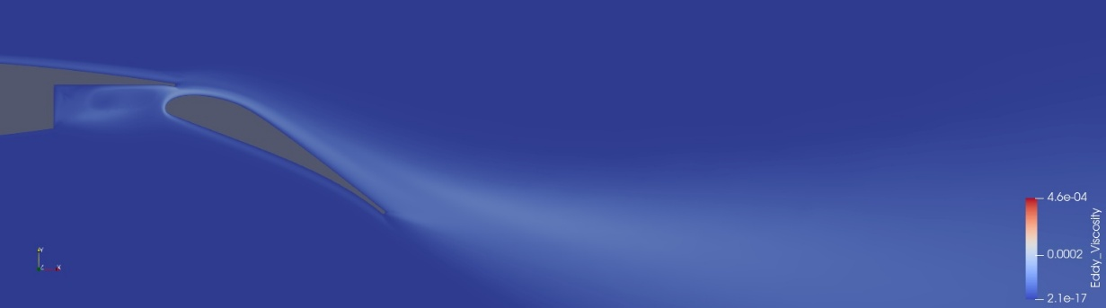
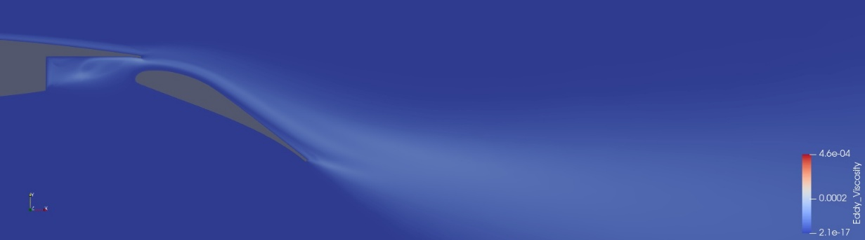
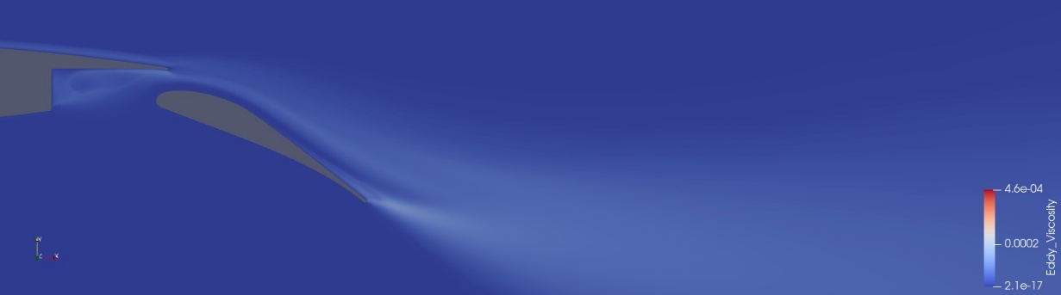
Eddy Viscosity
Fig 14: Baseline configuration
(x_gap at 3.0% & y_gap at 1.5% of the airfoil chord).
Fig 15: Optimized configuration (x_gap at 2.3% & y_gap at 4.0% of the airfoil chord).
Fig 16: Optimized configuration (x_gap at 4.3% & y_gap at 6.0% of the airfoil chord).
30° flap deflection
4° Angle of attack
Notes:
Here
Baseline:
Disturbed flow at LE,
Disturbed Channel Flow,
Disturbed Flow over the Flap Surface
x_gap at 2.3% & y_gap at 4.0%
Excels in Maximizing C_{L max}
x_gap at 4.3% & y_gap at 6.0%
Showcases better flow characteristics
On Flap’s Upper Surface & In the Flap Cutout

Slide 30
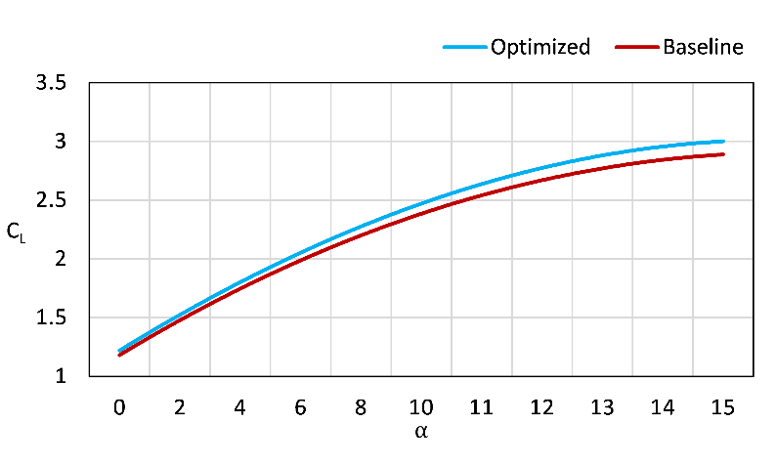
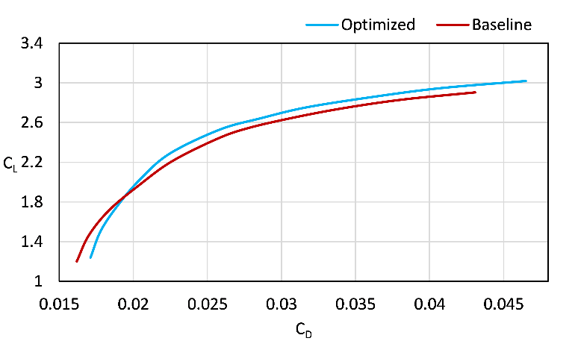
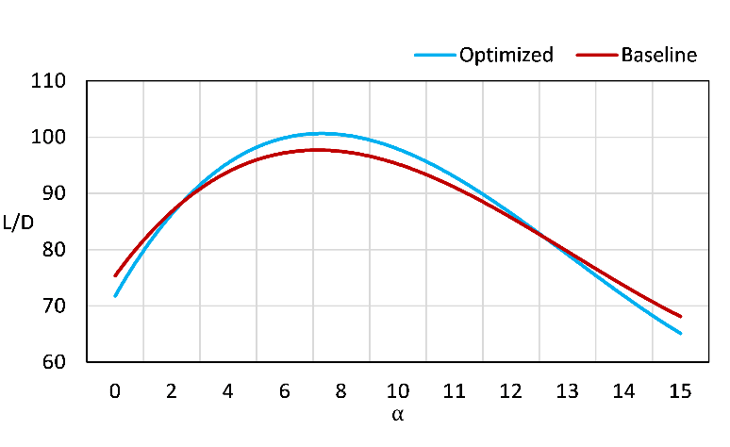
Aerodynamic performance at 15-degree flap deflection

Slide 31
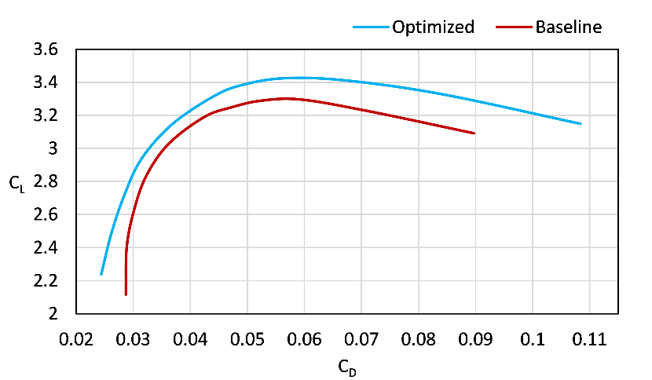
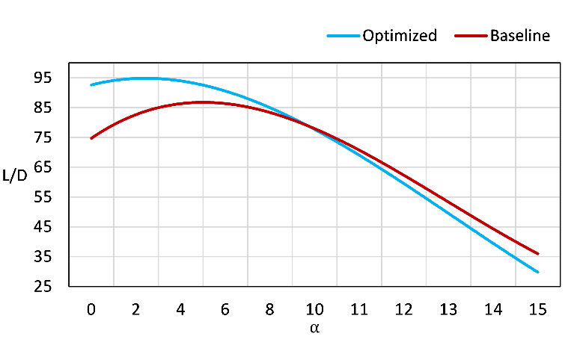
Aerodynamic performance at 30-degree flap deflection

